Slide 1



Slide 2





PRANA – The Life Force
1. Data-driven prediction of CO₂ levels
2. Funnel Focus: Target the significant causes
Waste incineration
Fuel combustion
3. Measures to achieve Sustainable Environment
Deforestation
4. Restore the Force of Life
Industrial emission
50 years
20 %
50 %
26 %
60 %

Slide 3
















BUSINESS IDEA
Less Pollution
Temperature Control
PRANA
Healthy Living
Afforestation

Slide 4







REASONS FOR AIR POLLUTION
Population Growth
Vehicle Emission
SUSTAINABILITY
Industrial Emission
Fuel Combustion

Slide 5





SOLUTION
Forecast CO₂ for next 10 years
Data-driven approach
LIFE FORCE
Listing of important reasons
Recommendations to lower down CO₂ level

Slide 6





DATA SOURCE
CO₂ Emission
Vehicle Sales
DATA
Deforestation
Population

Slide 7






THE TEAM
Dr Ravishankar Shivarama
Mentor
Netali Agarwal
Team Lead
Namana Maji
Rahul Saraf
Deeksha Lasrado
Sathwik Ravikanti

Slide 8
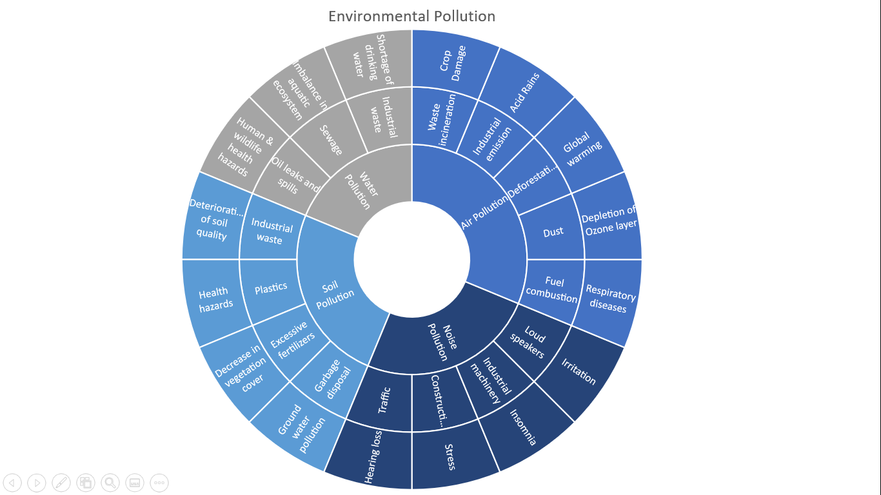
Types of Pollution, Causes and Impact of Pollution

Slide 9
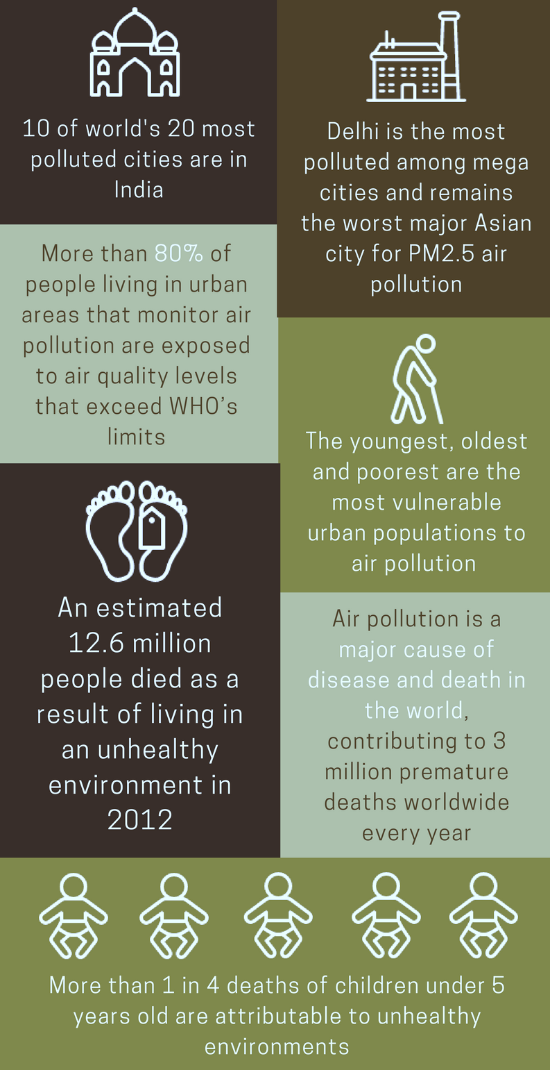
Air Pollution
7 Million Deaths Every Year
Types of Pollution, Causes and Impact of Pollution
Types of Pollution, Causes and Impact of Pollution
https://www.aqi.in/blog/7-facts-air-pollution/

Slide 10

Air Quality Index
Indicator of pollution level in the area.
Gauge from 0 to 500
6 categories based on level of health concern
Public health risk increases as AQI increases
In India, eight common pollutants used for AQI
PM2.5
PM10
CO
NO2
SO2
Ammonia
Ground Level Ozone
Lead
Notes:
In India, AQI calculations include the eight pollutants for which National Ambient Air Quality Standards (NAAQS) have been set.
These are PM10, PM2.5, nitrogen dioxide, sulphur dioxide, carbon monoxide, ground-level ozone, ammonia, and lead.

Slide 11
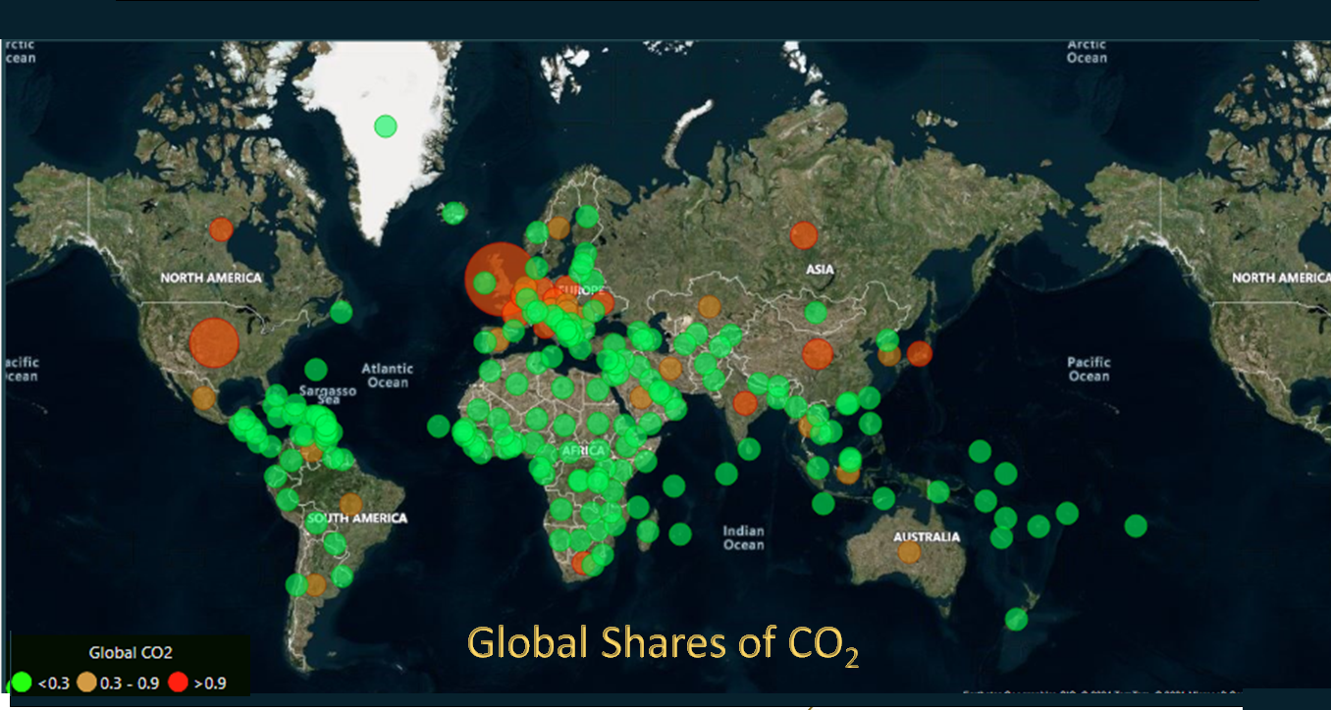

Slide 12
7.2%

Slide 13
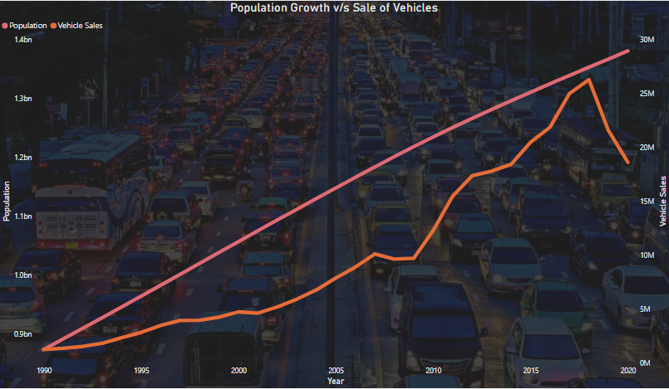
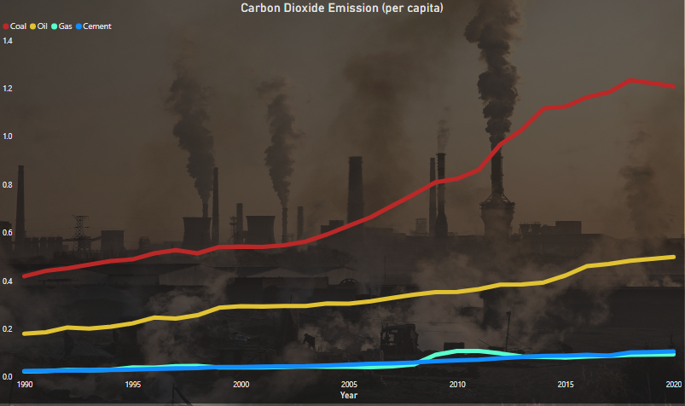
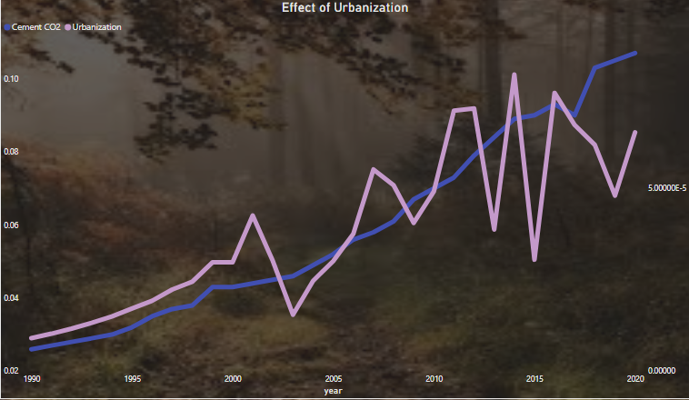
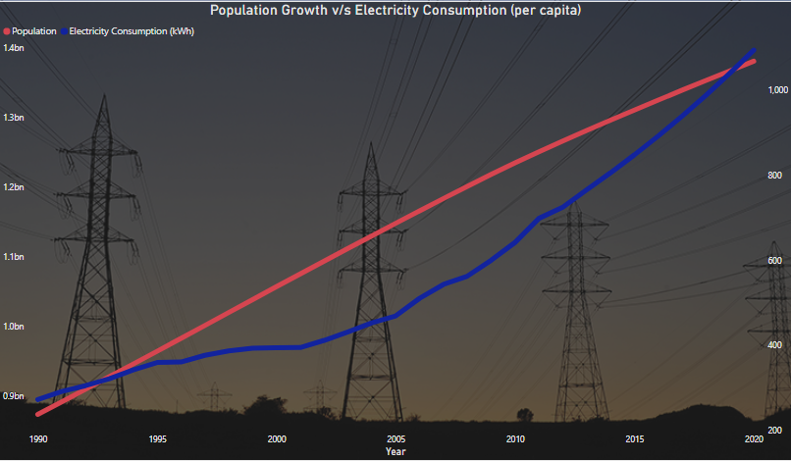
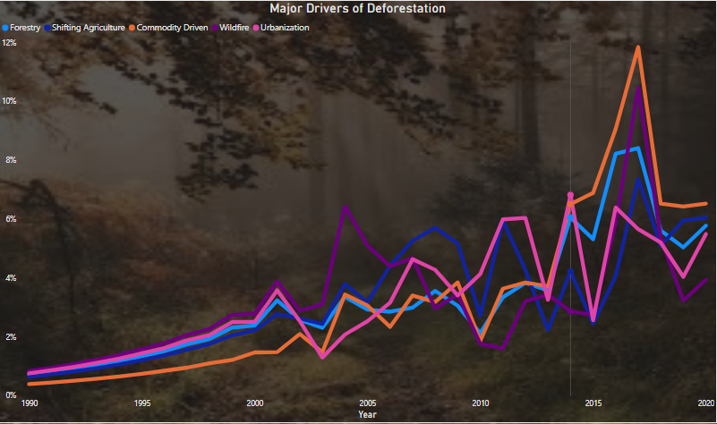
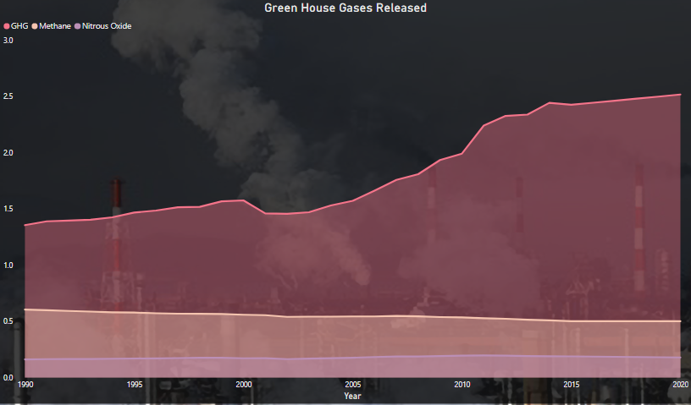
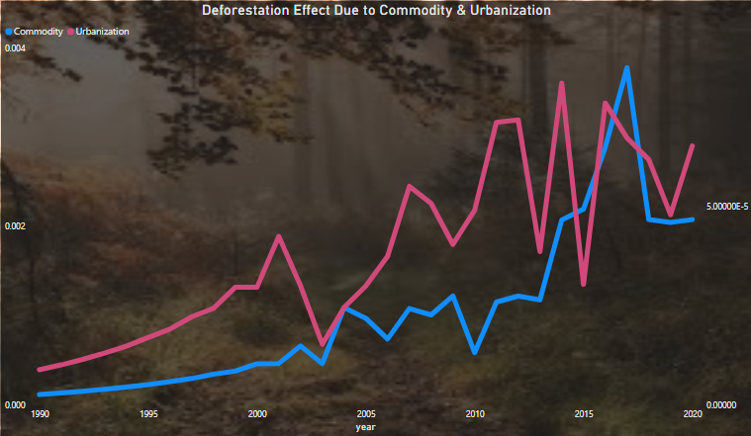
Carbon Dioxide Emission (per capita)
Effect of Urbanization
Population Growth Vs Electricity Consumption (per capita)
Green House Gases Released
Population Growth Vs Sale of Vehicles
Major Drivers of Deforestation
Deforestation Effect Due to Commodity & Urbanization

Slide 14




APPROACH
Features
Historical CO₂ Levels in India
Deforestation
Power consumption
Engineered Features
Per Capita of Features
Model
ARIMA (Auto Regressive Integrated Moving Average)
Result
Forecast CO₂ level for next 10 years in India

Slide 15
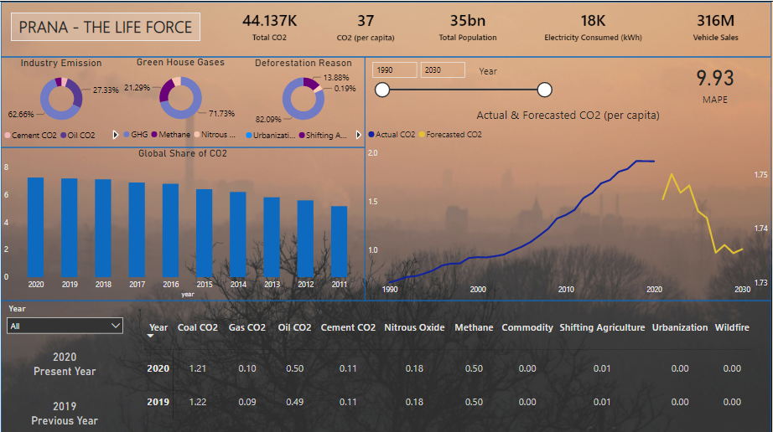

Slide 16






PRANA - ROADMAP
Collection of live data of various countries at a global level from different sources into a database in Cloud
Build a Machine learning model
Orchestration of pipelines
Structuring data in database – intra-country and inter country level
Conversion of Machine learning model to API in Cloud
Publish results in a website

Slide 17




RECOMMENDATION
1 |  | Switch to electric vehicles – opt energy efficient devices
2 |  | Segregate waste and reduce incineration of waste
3 |  | Reduce, Reuse and Recycle
4 |  | Reduce usage of electricity – Use renewables for power generation
5 |  | Reduce deforestation and encourage afforestation

Slide 18

THANK YOU
Together, let’s make breathing easier

Slide 19
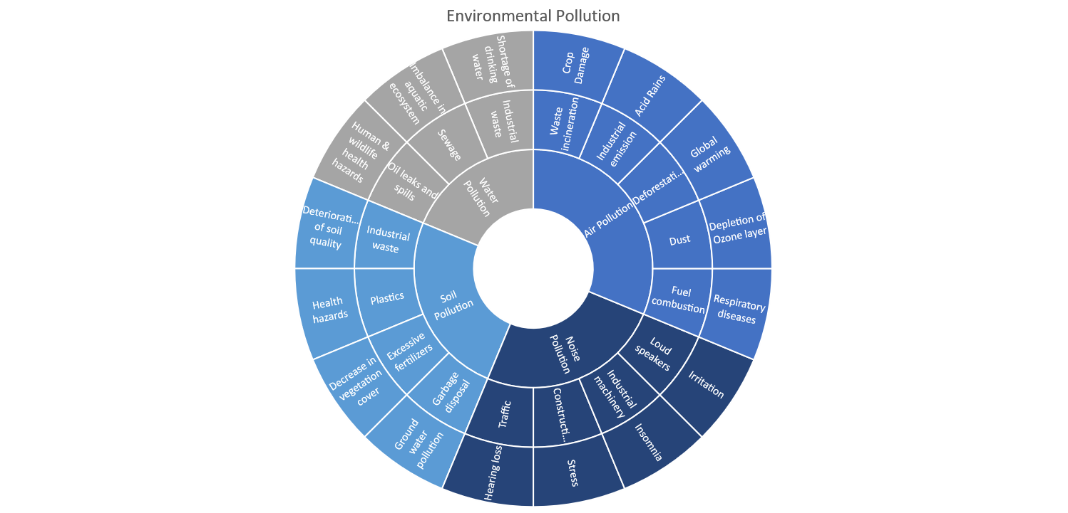

Slide 20
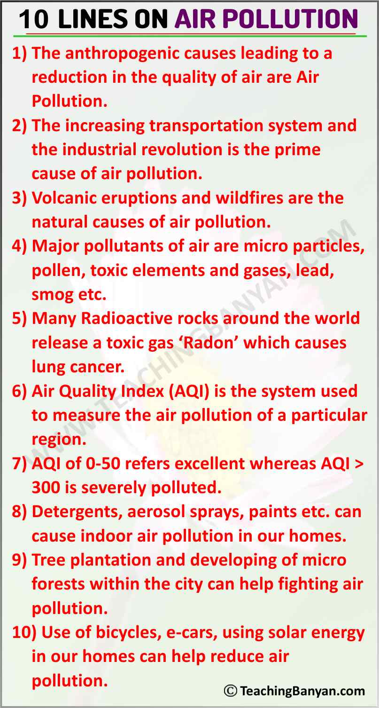

Slide 21
Agenda
Introduction
Approach
Results

